Slide 1
Lec -24
NETWORK LAYER: IP Address
(Subnetting and Super – netting examples ,IP header and IPv6 addressing )

Slide 2
What is Subnetting and Super-netting ?
The computer network is used to link the group of devices linked together to share resources and data.
Each network device has assign with id number known as an IP address.
Subnetting and Super - netting are two methods for organizing IP addresses in a logical order based on the situation.

Slide 3
Defi-nation of Subnetting and Super netting .
Subnetting is the technique of separating a network into sub-networks or in the subnetting large network is divided into small networks .
or
Dividing the network into smaller contiguous networks or subnets is called subnetting.
Super-netting is a technique which combines small networks into an large network.

Slide 4
Advantages of Sub-netting .
Advantages:
Subnetting increases the number of allowed hosts in the local area network.
Subnetting decreases the volume of broadcast, hence minimize the number of network traffic.
Sub networks are easy to maintain and manage.
Subnetting increases the flexibility of address.
Network security can be readily employed between sub networks rather than employing it in the whole network.

Slide 5
Disadvantages of subnetting .
Disadvantages
The process of subnetting is quite expensive.
To perform subnetting process, we need a trained administrator.

Slide 6
Advantages of Super – netting .
Super-netting reduces the traffic of the network over the internet.
Super-netting increases the speed of routing table lookup.
As it is summarized the number of routing information entries into a single entry, the size of the router’s memory table decreased, hence saving the memory space.
Provision for the router to isolate the topology changes from the other routers.

Slide 7
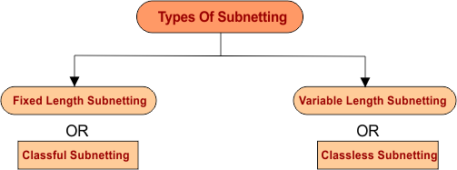
Types of Subnetting .

Slide 8
Fixed length Subnetting .
Fixed Length Subnetting- Fixed length subnetting also called as classful subnetting. Fixed length subnetting hold the following properties.
Sizes of all sub networks are same.
Subnets of all sub networks are same.
All the sub networks have equal number of hosts.

Slide 9
Variable Length Subnetting.
Variable length subnetting also called as classless subnetting. Variable length subnetting hold the following properties.
Sizes of all sub networks are not same.
Subnets of all sub networks are not same.
All the sub networks do not have the equal number of hosts.

Slide 10
Example of subnetting 10.0.0.1/26
Network ID = 10.0.0.1/26 find the subnetting
Step -1 The value of 64 host is 2^{6 .}
^{Step -2 -}
Total bits - Subnetting mask = 32- 26 = 6 bits .
^{Step -3 – IPv4 is 32 bits .}
8 +8+8 + 11000000 = 128 +64 =192.
Step -4 - Find the IP range .
^{255- 192 = 63.}
The network range we can give to network hosts from 0 to 63 .
^{Subnet mask = 255.255.255.192.}

Slide 11
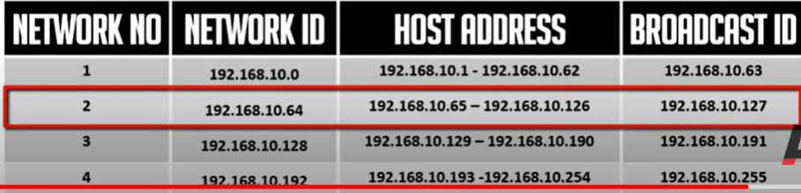

Slide 12
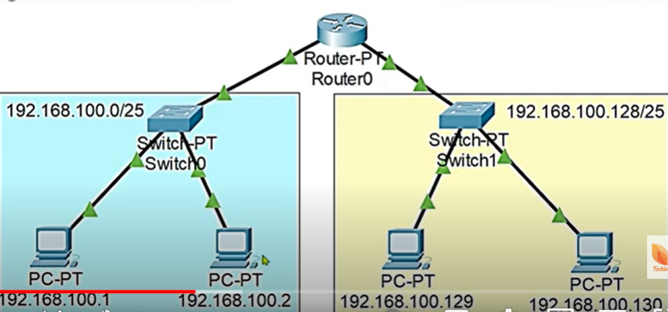
Implementation Example of subnetting perform on network Network ID- 192.168.100.0/25

Slide 13
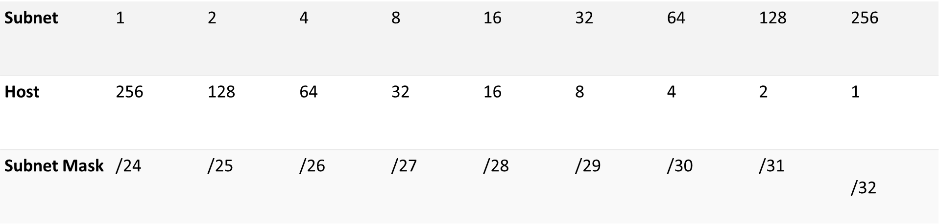
The values to check from the table .

Slide 14
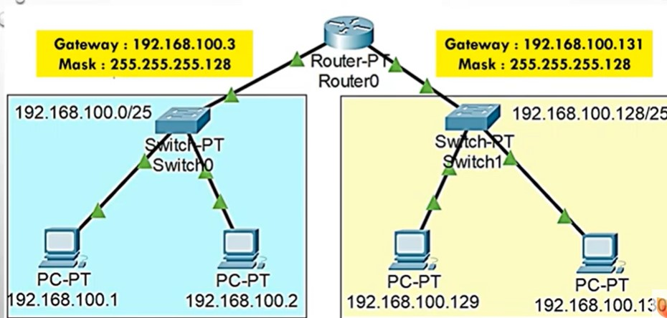
Example of subnetting .

Slide 15
Example of Subnetting .
Network ID = 192.168.100.0/ 25 find the subnetting
Step -1 The value of 128 host is 2^{7 .}
Step -2 - Move to third step :
Total bits - Subnetting mask = 32- 25 = 7 bits .
^{Step -3 – IPv4 is 32 bits .}
⁸ ⁺⁸⁺⁸ ⁺ ¹⁰⁰⁰⁰⁰⁰⁰ ⁼ ¹²⁸
Step -4 - Find the IP range .
²⁵⁵⁻ ¹²⁸ ⁼ ¹²⁷
The network range we can give to network from 0 to 127 .
^{Subnet mask = 255.255.255.128.}

Slide 16
Some Solve subnetting problems .
Network ID - 192.168.1.15/26 belongs to?
Step 1. Convert the shorthand subnet mask to decimal.
/26 = 255.255.255. + Two additional subnet bits.
Go to your cheat sheet, start at the bottom (128) and count up two, starting with 128. You should get to 192.
Thus, our decimal subnet mask is 255.255.255.192
Step 2. Determine the block size.
The block size is listed in the block size column parallel to your decimal mask.
The block size is 64.
Step 3. What is my Network ID?
Since we are working in the fourth octet and the block size is 64, the first network is 192.168.1.0.
Step 4. What is the next Network ID?
Again, we look at our block size of 64 to determine the next network is 192.168.1.64.
Network ID (First IP in the subnet): 192.168.1.0
Broadcast address (last IP in the subnet): 192.168.1.63
First Usable IP (the address after the network ID): 192.168.1.1
Last Usable IP (the address before the broadcast address): 192.168.1.62

Slide 17
How many subnets and hosts per subnet can you get from the network 192.168.1.0 255.255.255.224?
Netmask: 255.255.255.224 = 27 11111111.11111111.11111111.111 00000
Step 2: Determine how many additional subnet bits exist beyond the classful boundary.
Since this is a class C address, we are only going to look at the fourth octet. Since the decimal mask is 224, we know there were three subnet bits added (counting up from the bottom of our cheat sheet).
Step 3: Determine how many host bits remain.
We are still only working in the fourth octet. Since three bits went to the subnet in step 2, we have five host bits (0's) remaining.
Step 4: Find the exponents of both subnet bits and host bits using the cheat sheet:
Subnet Bits = 2^3 = 8
Host Bits = 2^5-2 = 30
The answer is 8 subnets and 30 hosts per subnet

Slide 18
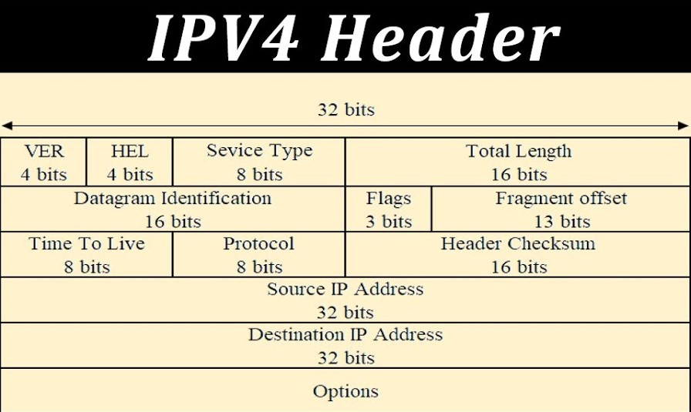
NETWORK LAYER: IP Addressing(IP Header).

Slide 19
Number of blocks and block size in classful IPv4 addressing .

Slide 20
IPv6 address.
The IPv6 address is 128 bits long and is arranged in eight groups, each of which is 16 bits. Each group is expressed as four hexadecimal digits and the groups are separated by colons.
An example of a full IPv6 address could be:
FE80:CD00:0000:0CDE:1257:0000:211E:729C

Slide 21
Types of IPv6 addresses.
There are different types and formats of IPv6 addresses, of which, it's notable to mention that there are no broadcast addresses in IPv6. Some examples of IPv6 formats include.
Global unicast. These addresses are routable on the internet and start with "2001:" as the prefix group. Global unicast addresses are the equivalent of IPv4 public addresses.
Unicast address. Used to identify the interface of an individual node.
Anycast address. Used to identify a group of interfaces on different nodes.
Multicast address. An address used to define multicast Multicasts are used to send a single packet to multiple destinations at one time.
Link local addresses. One of the two internal address types that are not routed on the internet. Link local addresses are used inside an internal network, are self-assigned and start with "fe80:" as the prefix group.
Unique local addresses. This is the other type of internal address that is not routed on the internet. Unique local addresses are equivalent to the IPv4 addresses 10.0.0.0/8, 172.16.0.0/12 and 192.168.0.0/16.

Slide 22
27-2 PACKET FORMAT
The IPv6 packet is shown in Figure 27.1. Each packet is composed of a mandatory base header followed by the payload. The payload consists of two parts: optional extension headers and data from an upper layer. The base header occupies 40 bytes, whereas the extension headers and data from the upper layer contain up to 65,535 bytes of information.

Slide 23
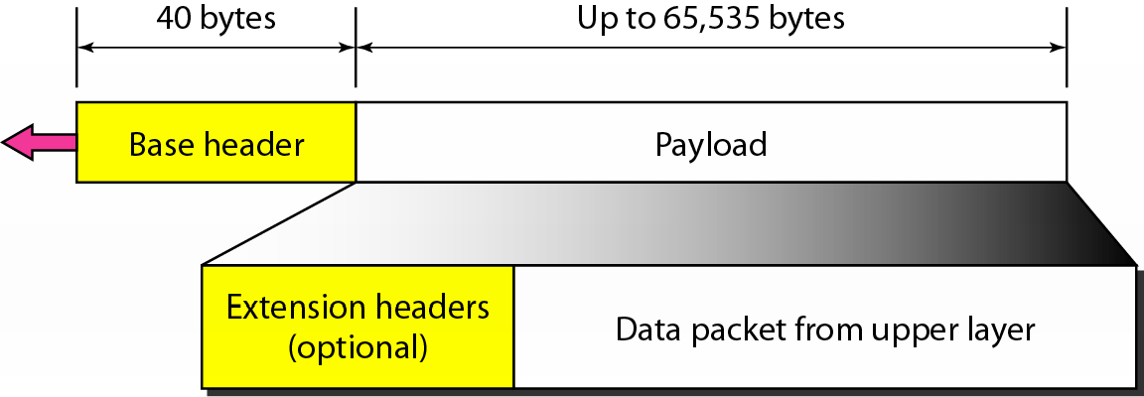
Figure 20.15 IPv6 datagram header and payload

Slide 24
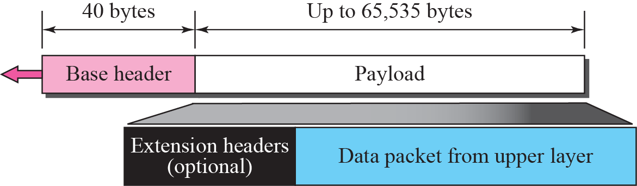
Figure 27.1 IPv6 datagram

Slide 25
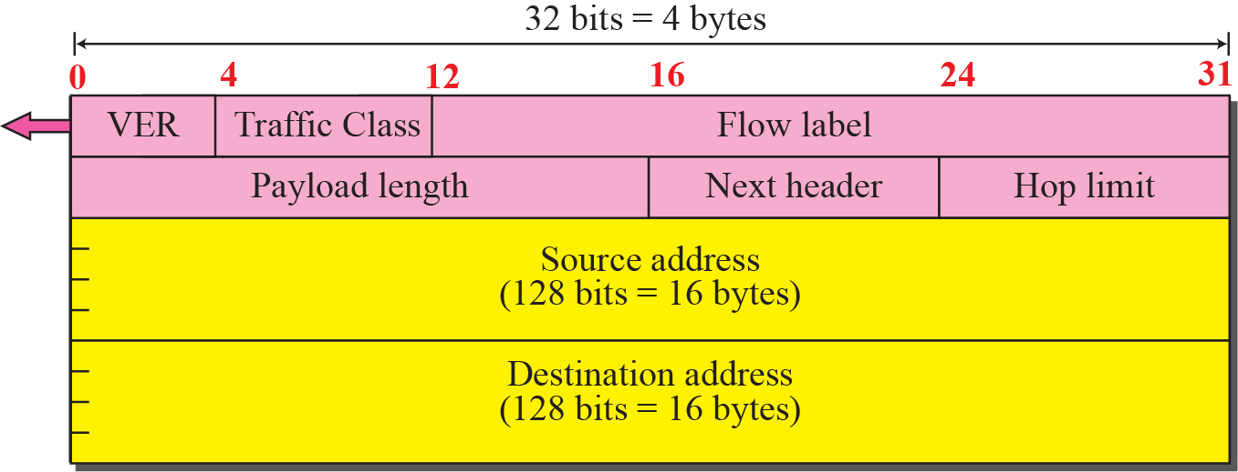
Figure 27.2 Format of the base header

Slide 26
Version. The 4-bit version field defines the version number of the IP. For IPv6, the value is 6.
❑ Traffic class. The 8-bit traffic class field is used to distinguish different payloads with different delivery requirements. It replaces the type-of-service field in IPv4.
❑ Flow label. The flow label is a 20-bit field that is designed to provide special handling for a particular flow of data. We will discuss this field later.
❑ Payload length. The 2-byte payload length field defines the length of the IP datagram excluding the header. Note that IPv4 defines two fields related to the length: header length and total length. In IPv6, the length of the base header is fixed (40 bytes); only the length of the payload needs to be defined..

Slide 27
❑ Next header. The next header is an 8-bit field defining the type of the first extension header (if present) or the type of the data that follows the base header in the datagram. This field is similar to the protocol field in IPv4, but we talk more about it when we discuss the payload

Slide 28
Hop limit. The 8-bit hop limit field serves the same purpose as the TTL field in IPv4.
❑ Source and destination addresses. The source address field is a 16-byte (128-bit) Internet address that identifies the original source of the datagram. The destination address field is a 16-byte (128-bit) Internet address that identifies the destination of the datagram.
❑ Payload. Compared to IPv4, the payload field in IPv6 has a different format

Slide 29
19-2 IPv6 ADDRESSES
Despite all short-term solutions, address depletion is still a long-term problem for the Internet. This and other problems in the IP protocol itself have been the motivation for IPv6.
Topics discussed in this section:
Structure Address Space

Slide 30
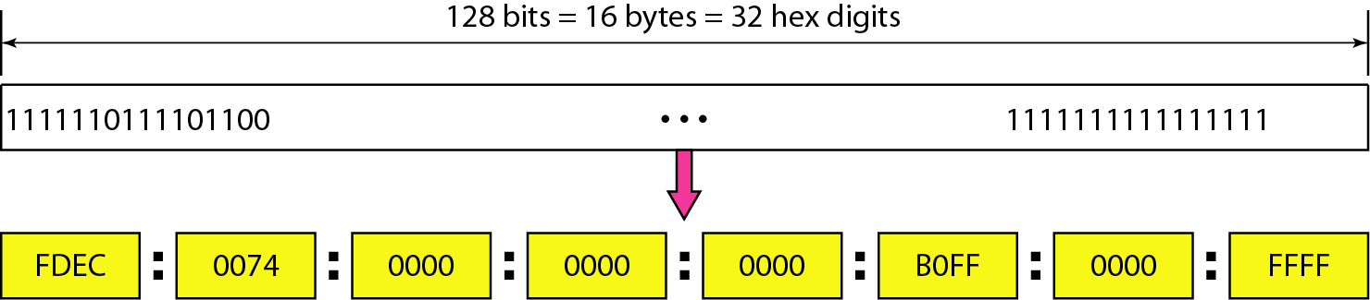
Figure 19.14 IPv6 address in binary and hexadecimal colon notation

Slide 31
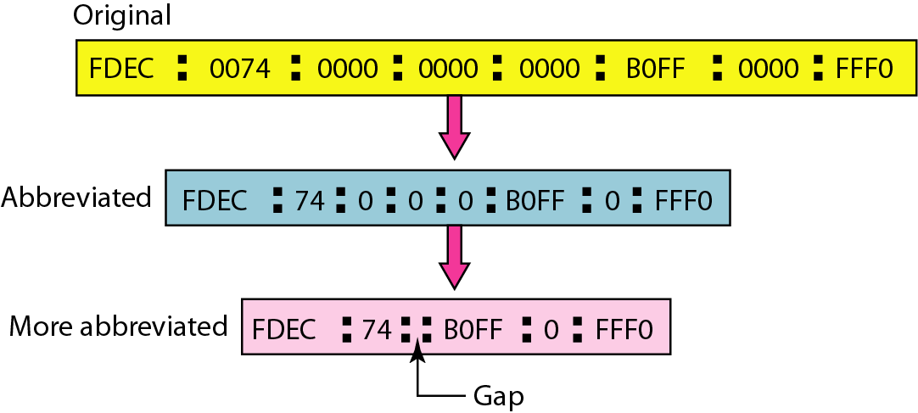
Figure 19.15 Abbreviated IPv6 addresses

Slide 32
Example 19.11 – Example of IPV6 to representation
Solution
We first need to align the left side of the double colon to the left of the original pattern and the right side of the double colon to the right of the original pattern to find how many 0s we need to replace the double colon.
This means that the original address is.

Slide 33
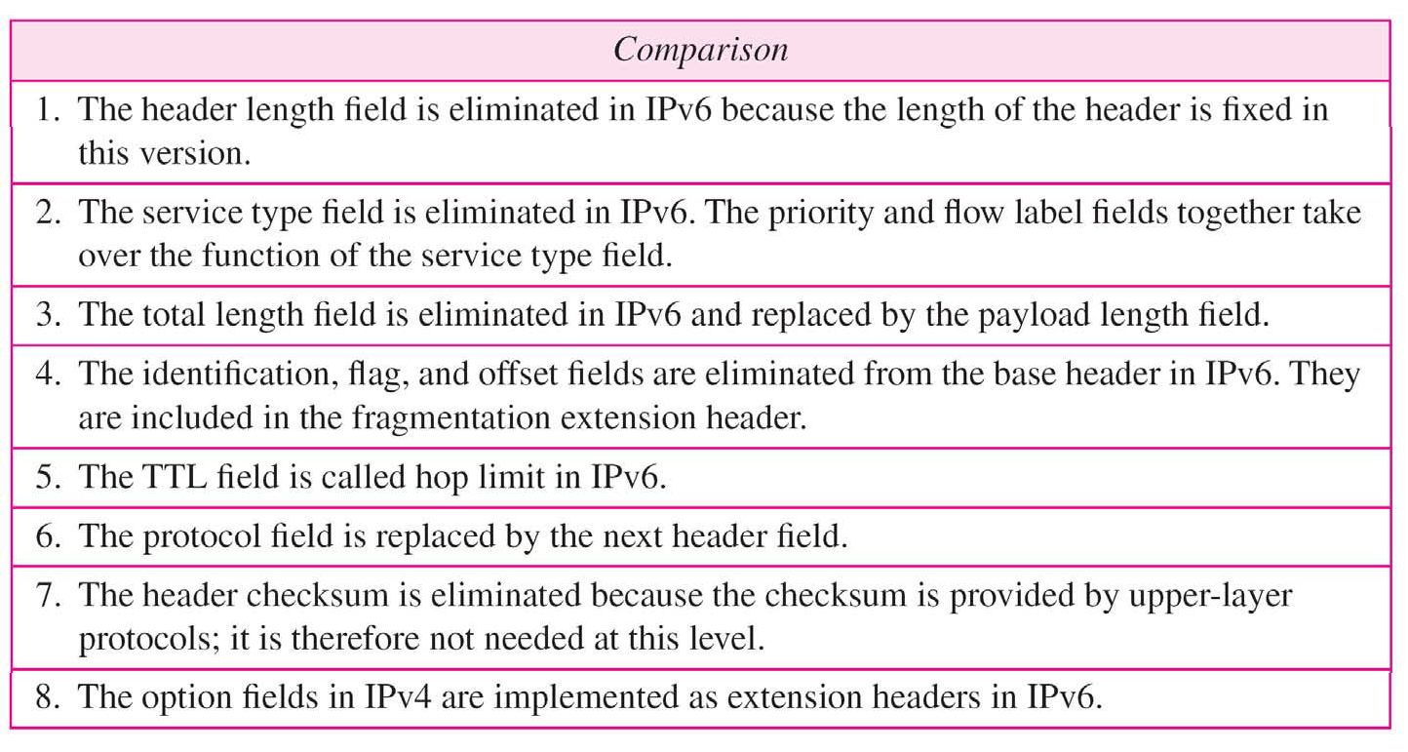
Table 20.9 Comparison between IPv4 and IPv6 packet headers

Slide 34


